Slide 1
Public Speaking
Scouts BSA

Slide 2
Safety
Follow your family’s rules for going online
Protect your privacy
Do not open emails or files from people you do not know or trust
If you receive/discover information that makes you uncomfortable, leave it and tell your parents
Do not believe everything you see or read online
NEVER agree to get together with someone you “meet” online
NEVER give personal information like email, phone number, address
NEVER share your Internet passwords with anyone
NEVER shop online unless you have your parent’s permission to do so
Be a good online citizen

Slide 3
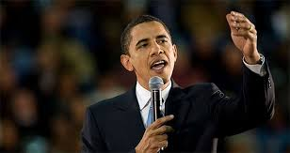
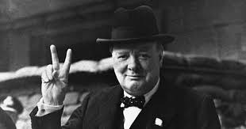
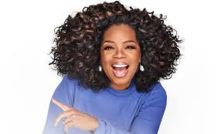
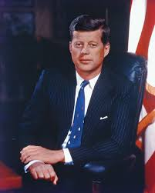
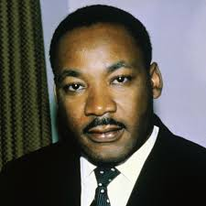
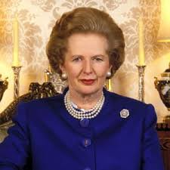
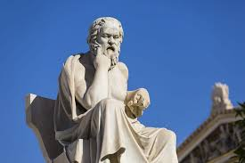
Notes:
Obama, Churchill, Winfrey, Kennedy, Thatcher, King, Socrates

Slide 4
Public Speaking
The act of performing a speech
live audience: single person or group of listeners
in a structured manner
formal
inform, entertain, convince, or persuade
aspects
pick a topic, write a speech, answer audience questions

Slide 5
Brief History of Public Speaking
GREECE
2,500 years ago in ancient Athens
civic duty
legislative assembly
court
(sometimes to defend themselves - no lawyers for average Athenian)
citizens meet in the marketplace to debate war, economics and politics
speaking skills: essential for a prominent social life, especially for the wealthy

Slide 6
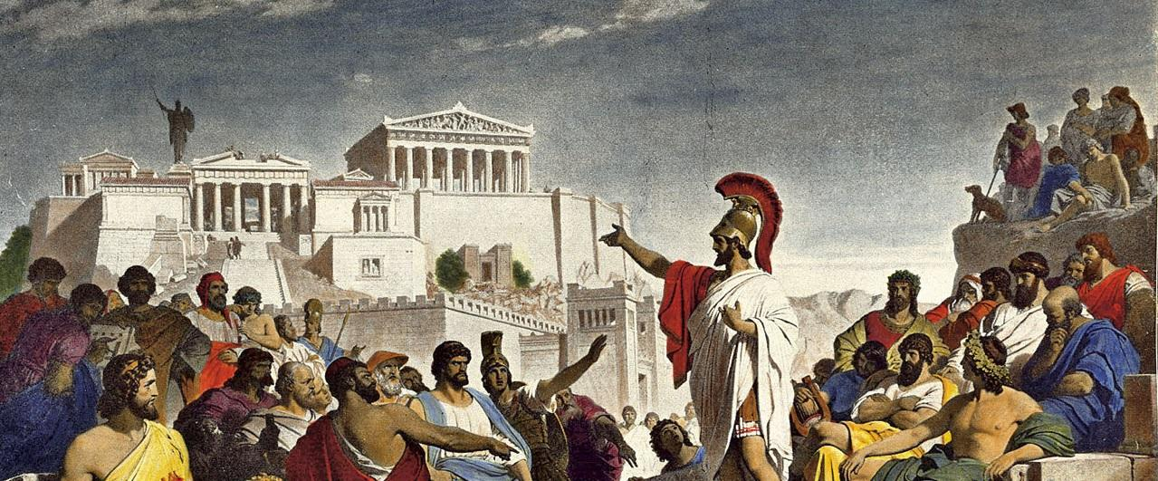

Slide 7
Brief History of Public Speaking
GREECE
Aristotle
defined RHETORIC, the means of persuasion in reference to any subject
Quintilian
published a twelve-volume textbook on rhetoric still used today by politicians
inherently moral and the ideal orator is “a good man speaking well”
Cicero
most famous for creating the five canons of rhetoric, a five-step process for developing a persuasive speech that we still use to teach public speaking today

Slide 8
Brief History of Public Speaking
Rhetoric
to rally the citizens into conformity
the capacity to persuade people
3 strategies
Ethos
source is credible and the speaker is an authority on the subject matter
Logos
logic and rational argument
Pathos
emotional appeal
Ethos, Pathos, Logos: 3 Pillars of Public Speaking and Persuasion

Slide 9
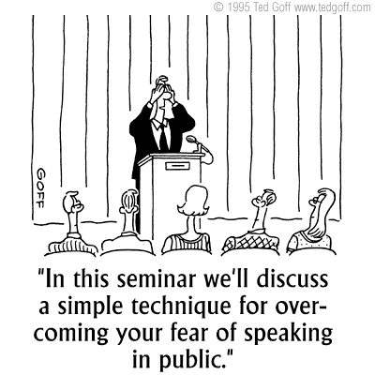
Modern Public Speaking
Conference
Business meeting
Sales pitch
Award ceremony
Teaching
Media event
Civic or community meeting
Political event/debate
Presentation in class, club, or troop
Social events: weddings, funerals

Slide 10
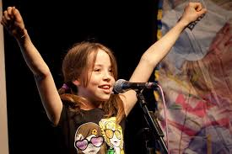
Benefits of Public Speaking
Career advancement
Boost confidence
Critical thinking
Personal development
Improve communication skills
Personal Satisfaction
Network: Professional and Personal
Learn to persuade
Build leadership skills
Learn performance skills
Develop vocabulary and fluency
Decrease fear of impromptu speaking
Learn to argue
Drive change (in policy or attitude)
Be a better listener

Slide 11
Public Speaking
5 basic elements
communicator/speaker
shares message
message
info shared
medium/channel
means by which info is shared
audience/listener
receives message
feedback
many forms: verbal/written response/survey, must be understood
interference
anything that interferes/impedes message
situation
time, place of communication

Slide 12
Public Speaking
Inform
present facts/instructions
https://www.youtube.com/watch?v=StPSgqwCnVk
Entertain
using humor relevant to the topic to keep audience attention
https://www.youtube.com/watch?v=jVoHcnaxEfQ
Convince
influence audience attitude
make audience believe/accept point of view or stimulate/inspire them
https://www.youtube.com/watch?v=Kh9GbYugA1Y
Persuade
seek active response from audience: voting, signing petition, changing a behavior
https://www.youtube.com/watch?v=dIIhbjY4s8A

Slide 13
Public Speaking
Persuasive Approach
deductive
state what you want audience to do
vote, save a river, host a student, sign up for something
inductive
use reason and arguments for lead up to the conclusion
“rolling thunder approach”
one sided
state the side of the issue that you support
two sided or multi-faceted
address both sides of issue or multiple facets
champion your side and argue against others
Small changes are easier for people.

Slide 14
Delivery
Manuscript
read only for absolute accuracy
Memorized
seldom
practice until comfortable
Impromptu
speaking with little or no prep
do only if comfortable with subject
take a beat and think before speaking
Extemporaneously
Carefully prepared and delivered with brief notes
Should sound spontaneous, even with extensive prep

Slide 15
Public Speaking and Conversation
Organize thoughts
giving directions to your house
Tailor message to audience
age and background
Telling a story for max impact
build to the punchline
Adapt to listener feedback
verbal
nonverbal: looks of confusion, offense/pain, hurt

Slide 16
Public Speaking vs Conversation
Structure
time limit
uninterrupted. questions held to the end
Formal language
no slang, jargon, poor grammar
Formal delivery
no vocalized pauses: “um, and, uh”
do not repeat stock phrases: “basically, you know, I mean”

Slide 17
Public Speaking
Audience centered
purpose of speech: desired response - believe or do?
who are they?
what style would be effective?
egocentric: how does this affect me? Why should I care?
Speech
2 messages
one the speaker presents
one the audience hears

Slide 18
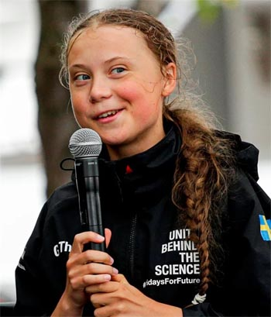

Slide 19
Purpose of Speech: Idea Organization
Chronological Order
past/present/future
Problem and Solution
state a problem, offer solution
depending on audience knowledge base, focus on problem and solution OR just solution
Analogy or Metaphor
compare your idea to a similar idea or object
ex: giving a speech is like the flight of an airplane - takeoff is the intro, the flight is the body of the speech, the passengers are the audience, the pilot is the speaker, and the landing is the conclusion
Cause and Effect
scientific discussions
problem, causation, impact

Slide 20
Purpose of Speech: Idea Organization
Divide a Word
word as an acronym or mnemonic device to demo idea
Mine a Phrase
introduce your idea with a relevant quote/phrase
Segment a Topic
divide topic into sections based on your own organizational pattern
ex. : scout camp: divide into different sections or basketball: plays or team positions
Numerical List
grab immediate attention with easy organization
keep list short to make greater impact

Slide 22
Inspiration and Reinforcement
Quotes
Bartlett’s Familiar Quotations
Anecdotes
Statistics
The New York Times Almanac
Reader’s Guide to Periodical Literature
The New Times Index
science related search engines: www.scirus.com
Offbeat Facts
Magpies are considered one of the most intelligent animals in the world, and the only non-mammal species able to recognize itself in a mirror test.

Slide 23
Outline
Introduction
recognize the person who introduced you
voice your appreciation for the chance to speak before the group
arouse interest in subject- let the audience know what you want to accomplish
short
grab the audience’s attention
question
startling statement
personal experience
something familiar
humor
historic survey
myth/legend/quote/short story

Slide 24
Outline
Body
main part of speech
develop each idea on list using
facts, opinions, reasons, quotes, examples, personal stories, analogies, statistics
3 main points
3 examples for each point
logical order and interwoven
transitional phrases
on another point
to summarize
now let’s take a look at
in addition
the next point is
turning to
another area for consideration is

Slide 25
Outline
Conclusion
completes your speech: closure
summation of argument or call to action
final good impression
short
phrases
in closing
to wrap up
I have one final thought

Slide 26
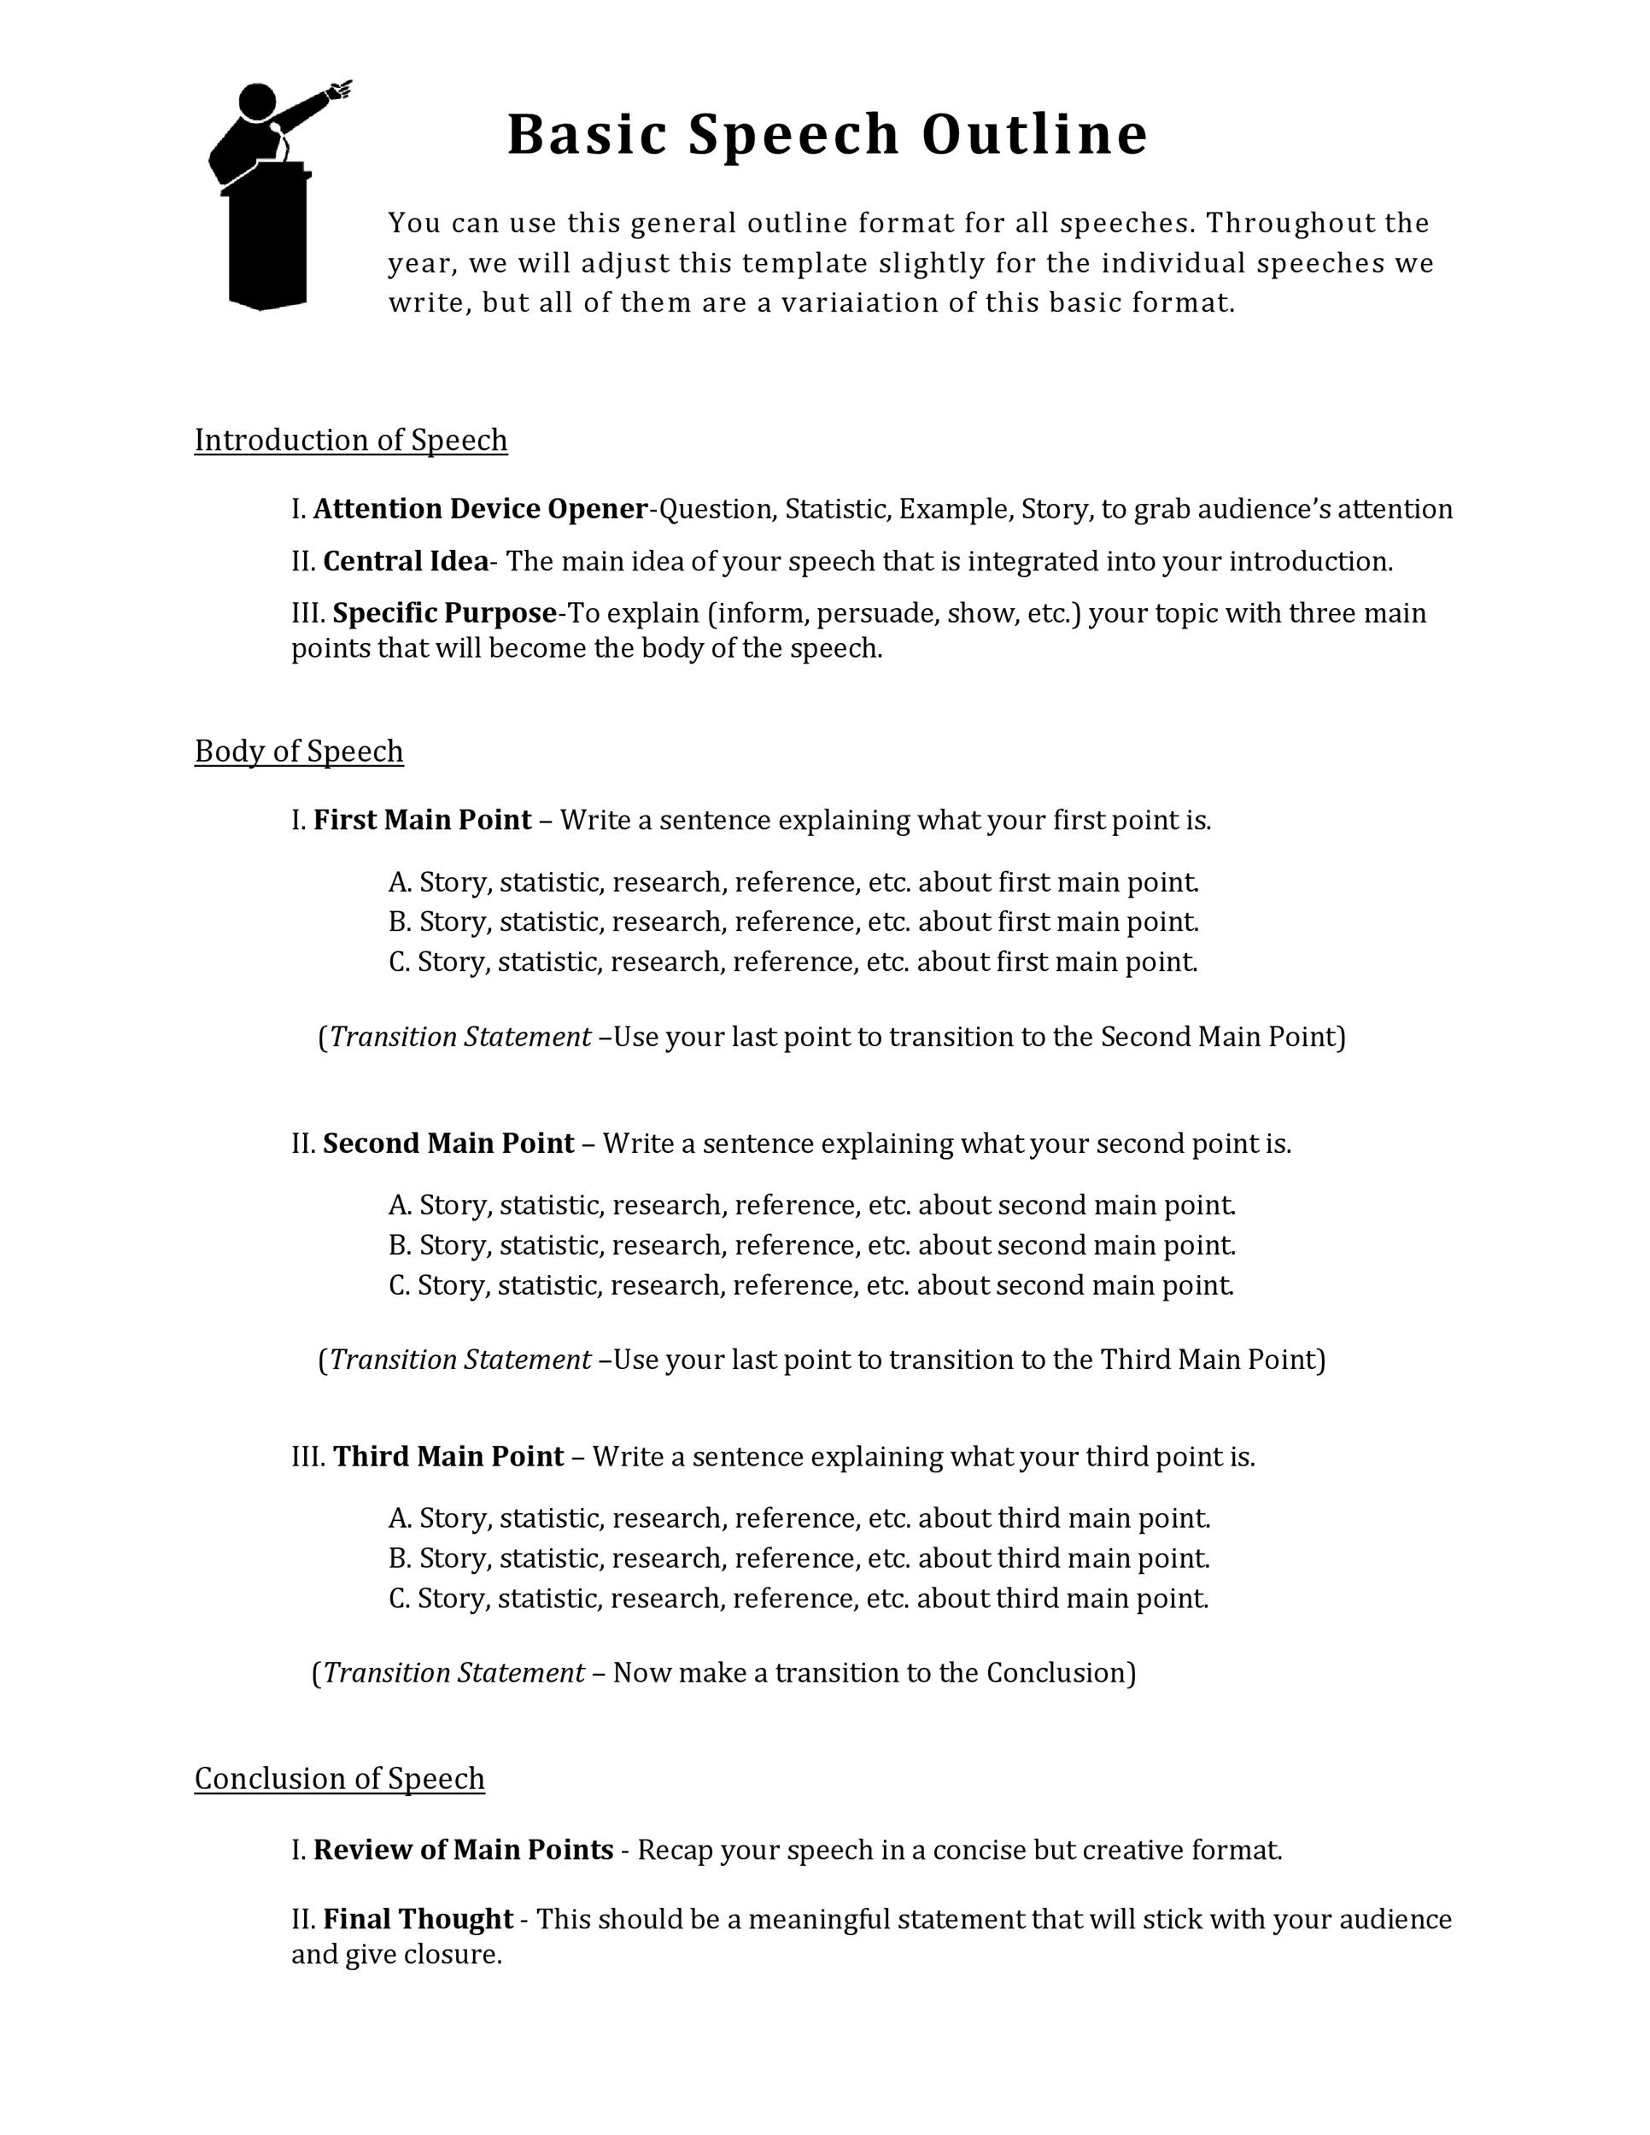
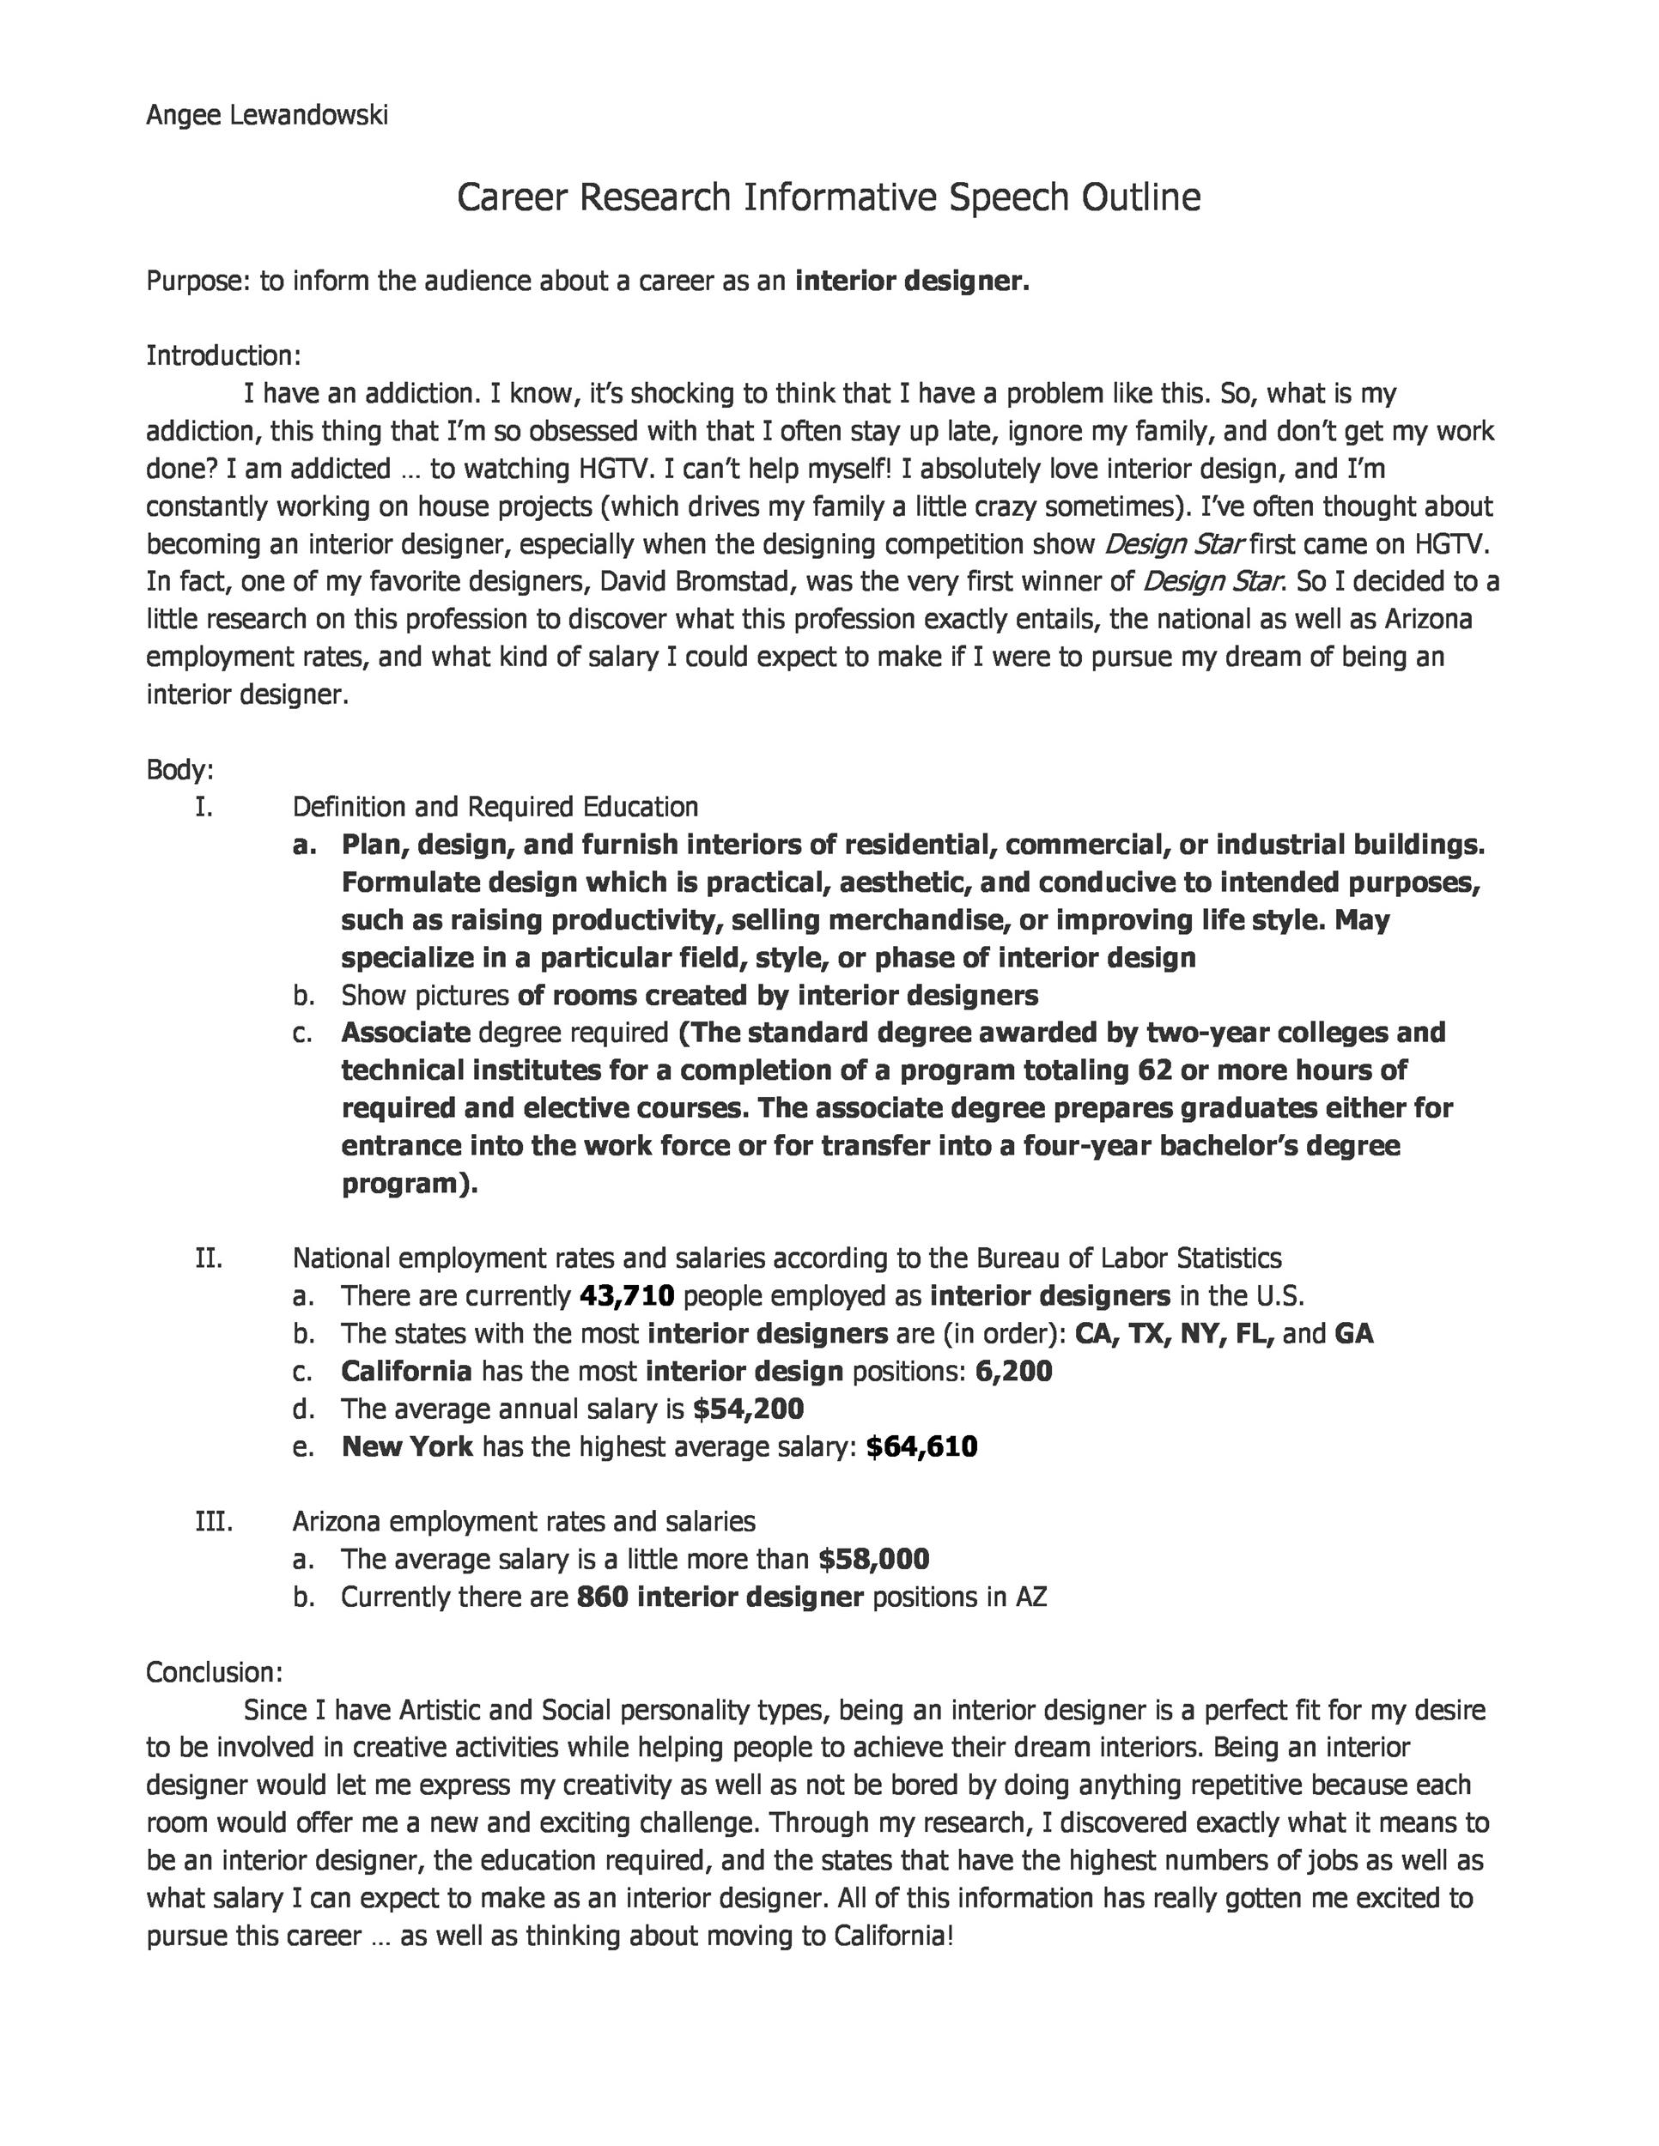

Slide 27
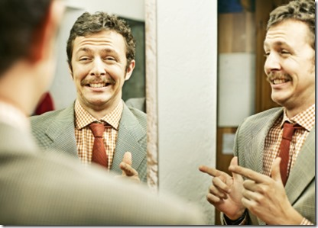
Performance
PRACTICE
mirror
family or friends
Feedback
request critique during practice
eye contact
body language
hands
speech delivery

Slide 28
Performance
Relax
back stage: Take a few deep breaths, yawn. visualize an entertained audience
concentrate on how good you are at speaking
pretend you are just chatting with a group of friends
BE PREPARED - outline your speech, memorize your opening lines
PRACTICE, PRACTICE, PRACTICE
go to bathroom
if you feel shaky, don’t hold notes. Hold onto the podium if needed.
if legs wobble, lean your knee against the podium

Slide 29
Performance
Prep room
equipment
mic
computer/projection equipment
lectern
visual aid
lighting
temperature
seating and layout

Slide 30
Performance
Good impression
calmly walk to “stage”
shake hands and make eye contact with intro person
thank them and smile
make eye contact with audience with sincerity
stand straight with feet slightly apart and arms relaxed
make casual emphasis with gestures
natural body language
lean toward the audience
fumble a line/
slow down and take a breath before restarting
do not apologize
at conclusion, tell audience you will take questions after
smile and walk calmly from “stage”

Slide 31
Visual Aid
Simple, used for emphasis and variety
Slides
reasonable timing
takes 20 sec to register visualized item
legible font
Lower case, unless upper case is necessary
Charts and graphs
Flip chart
blue or black ink
Drawings
Equipment
Product

Slide 33
Requirement 1
Give a 3-5 minute introduction of yourself to an audience such as your troop, class at school, or some other group.

Slide 34
Mrs. Maddie Williams, MSN, CNM
Nurse Midwife
Mother of 3: 12 year old twins, 7 year old son
Married for 17 years
Originally from east coast, MD. Lived in Memphis 24 years
Cosplayer
Loves reading, podcasts, and binge-watching shows

Slide 35
Requirement 2
Prepare a 3-5 minute talk on a topic of your choice that incorporates body language and visual aids.

Slide 36
Requirement 2
Persuasive
Air pollution
Animal rescues
Blood donation
Bullying
Cancel culture
Climate change
Divorce
Eating disorders
Exercise
Existence of aliens
Existence of sasquatch
Fad diets
Gay marriage
GMOs
Gun control
Helmet laws
Homelessness
Legalization of marijuana
National health care
Nuclear weapons
Sexual harassment
Teen drinking
Vegetarianism/Veganism
Working parents
Informative
Book review
Exotic pets
Bio of famous person
Evolution of video games
National park
Dog breed
Origin of a holiday
Types of poisonous plants
How to get good grades
Interesting culture
Type of food
Describe life in another country
Famous landmark
History of favorite product/brand
History of comic books
Local folklore
Origin of superstition
History of your town
Dyslexia
Branches of the military
Life in the future
Professional sports team
Your favorite vacation spot
Compare different religions

Slide 37
Requirement 3
Give an impromptu talk of at least 2 minutes either as part of a group discussion or before your counselor. Use a subject selected by your counselor that is interesting to you but that is not known to you in advance and for which you do not have time to prepare.

Slide 38
Requirement 3
Home safety
Life on other plants
Pizza
Most memorable character
Coping with siblings
Coping with quarantine
Mistakes I’ve made
News story I’m tired of
Memorable book
Memorable movie
Favorite actor
Favorite TV show
Favorite sport
Bears
Best pet to have
Favorite day of the year
Favorite campout meal
Best way to get exercise
How to make lots of money
What makes me really mad
If I could invent a candy
How to promote world peace
Best car to own
Best city to live in
Best vacation
Rescue vs purebred dog

Slide 39
Requirement 4
Select a topic of interest to your audience. Collect and organize information about the topic and prepare an outline. Write an 8-10 minute speech, practice it, then deliver it in a conversational way.

Slide 40
Requirement 4
Favorite era in history
Coolest historical figure
Coolest historical event
Music festivals
Favorite musician
Correct way to brush and floss
Exotic fruit or vegetable
Child labor
Musical instrument
Music genre/historical origin
How to pot/care for a plant
Type of bird
Favorite cryptid
Famous Eagle Scout
Famous female scientist/inventor
Boardgame
Best game I have ever played
Character I would like to be (from movie or game)
Ways to relax
The Ice Age: when, how, and causes
How to organize a fun campout
Interesting country
Fashion trend
Skateboarding tips/tricks, safety
Foreign flag and their history
Pride month
Origin of holiday traditions
My hobby

Slide 41
Requirement 5
Show you know parliamentary procedure by leading a discussion or meeting according to accepted rules of order, or by answering questions on the rules of order.

Slide 42
Requirement 5: Parliamentary Procedure
Formal meeting ground rules
leader/chair conducts all the business
chair offers
opening statement
closing statement
summarizing topic, agreements and disagreements
starting questions
encouraging quiet members and discouraging domineering ones
speakers must be recognized by the chair
individual questions are also directed to the chair
more a debate of opposing ideas - seeking audience approval
encourages fair representation of the members

Slide 43
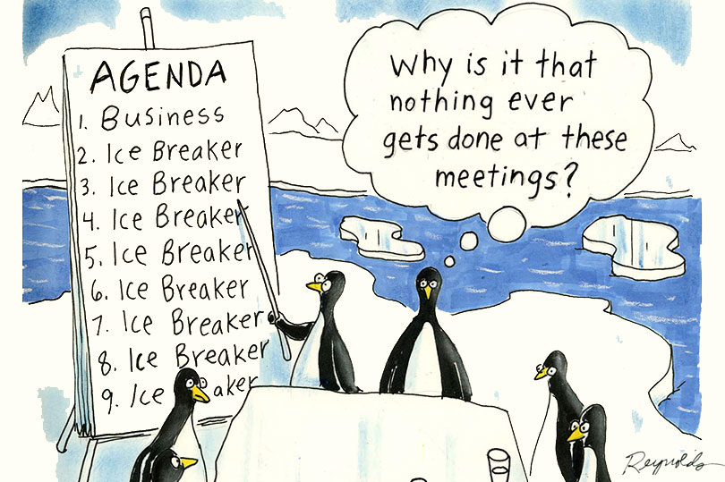
Requirement 5: Parliamentary Procedure
Group decision making
board of directors
corporate meetings
association meetings
government entities
legislative bodies
places of worship
community associations
civic and volunteer groups

Slide 44
Requirement 5: Parliamentary Procedure
Robert’s Rules of Order
12th edition
common, basic
based on regard of the rights of the majority, of the minority, especially a strong minority - greater than ⅓ of individual members, of absentees, and of all these together. the means of protecting all these rights in appropriate measure forms much of the substance of parliamentary law, and the need for this protection dictates the degree of development that the subject has undergone.

Slide 45
Requirement 5: Parliamentary Procedure
10 principles
group must have authority to take the actions it purports to take
must be a meeting of the decision making group
proper notice of the meeting must be given to all members
must be a quorum present at the meeting
must be a question present for the group to make a decision about
must be opportunity to debate the question
the question must be decided by taking a vote
must be a majority vote to make a decision or take an action
must be no fraud, trickery, or deception resulting in injury to another member
to be valid, any action or decision of a body must not violate any applicable law or constitutional provision

Slide 47
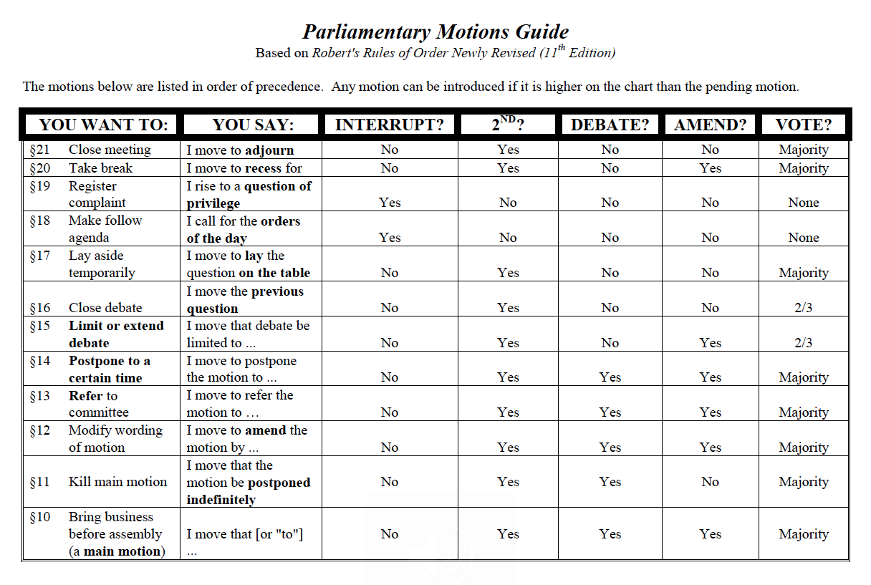

Slide 48
